Slide 1

Santosh Kumar Kar,
skkar.2k2@gmail.com

Slide 2
CHAPTER – 4
Spring Boot Starter Data JPA

Slide 3
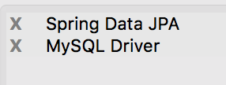
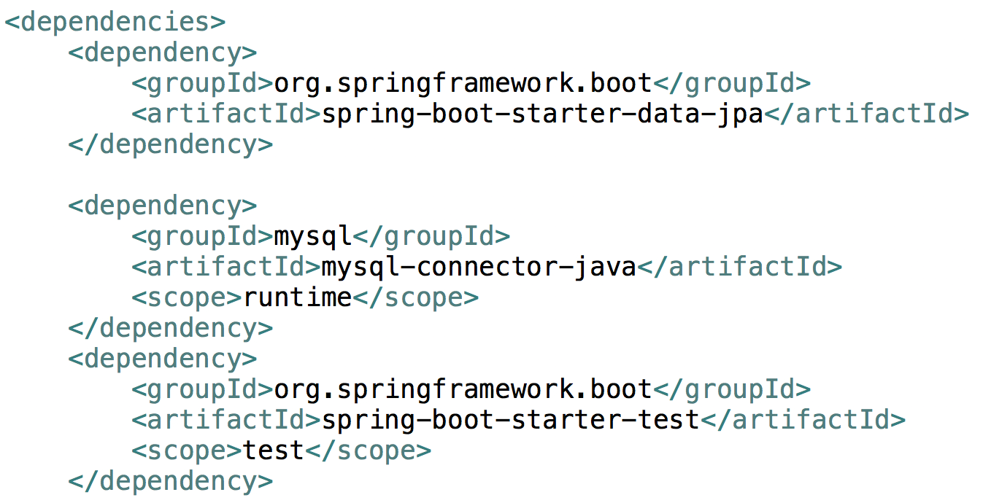
Spring Data JPA

Slide 4

Questions
Send to skkar.2k2@gmail.com

